Slide 1
Sector Overview and DEA Post Harvest Assistance Scheme
Entrepreneurship Development Program - Gampaha
Upul Ranaweera
Director (Development)
Department of Export Agriculture

Slide 2
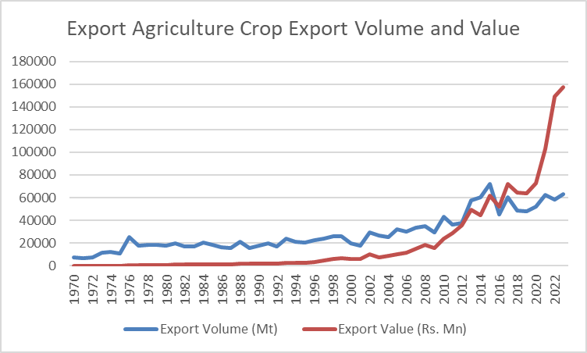

Slide 3
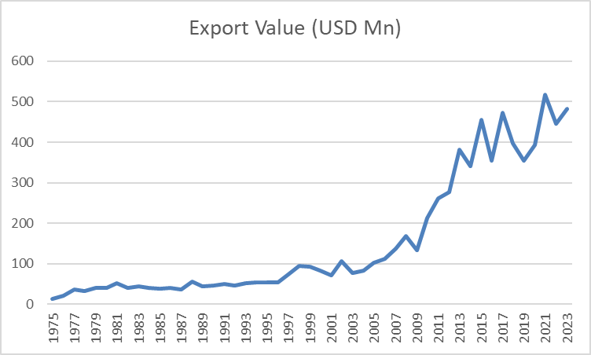

Slide 4
Main Spice Export From SL
Name of the Product | Export Quantity (2021) MT | Export Value(2021)-RS MN | Export Quantity (2022) | Export Value (2022) RS MN | Export Quantity (2023) | Export Value (2023) RS MN
Cinnamon & Cinnamon based products | 19,195 | 49,893 | 18,820 | 74,886 | 20,133.13 | 70,063.92
Cloves and Cloves based products | 6,487 | 6,980 | 2,338 | 6,708 | 5,852.12 | 14,993.34
Pepper | 18,040 | 23,293 | 11,508 | 24,717 | 14,507.81 | 32,393.54
Cocoa | 1,475 | 2,274 | 1,711 | 4,212 | 1,985.09 | 5,649.86
Arecanut | 10,516 | 8,670 | 16,978 | 21,187 | 14,051.38 | 19,686.13
Nutmeg | 1,760 | 2,931 | 2,041 | 5,417 | 2,782.33 | 7,810.78
Sri Lanka Customs

Slide 5
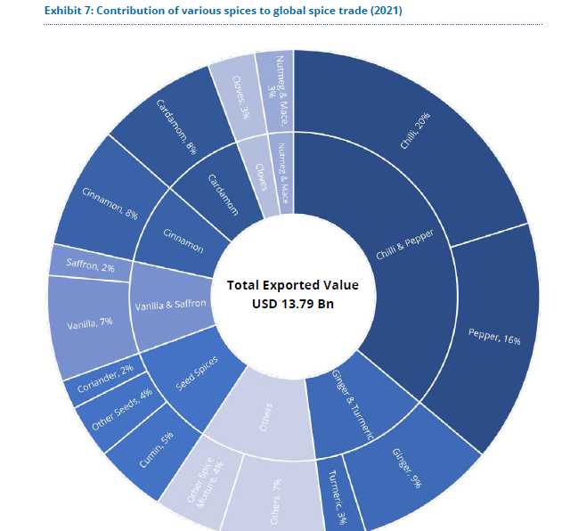
World Spice Export
USD 13.79 Bn
Chilli 20%
Pepper 16%
Ginger 9%
Cinnamon 8%
Cardamom 8%
Vanilla 7%
Turmeric 3%
Clove 3%
Nutmeg & Mace 3%
Source: Yes Bank, India 2022

Slide 6
Why Does Sri Lankan Spice Sector need Entrepreneurs?

Slide 7
Sri Lankan Spice Production in the World Context
Spice | Sri Lanka's Contribution (%)
Cinnamon | 15-20%
Pepper | 3-5%
Cloves | 2-5%
Cardamom | 1-2%
Nutmeg | 1-2%
Mace | 1-2%
Turmeric | 2-5%
Ginger | 1-3%
Vanilla | 1-2%

Slide 8
Trends of the International Spice Market
Consistence of Quality
Consistence of Supply
Free from toxins (Agrochemicals, Heavy Metals, Aflatoxins, Bacteria, Petroleum)
Growth of the processed food industry (Oil, Oleoresin, Natural colouring)
Demand for Natural Spices
Demand for sustainable Agricultural products
Medicinal plants/

Slide 9
Trends of the International Spice Market
Demand for Organic and other certified products
Traceability
Certification

Slide 10
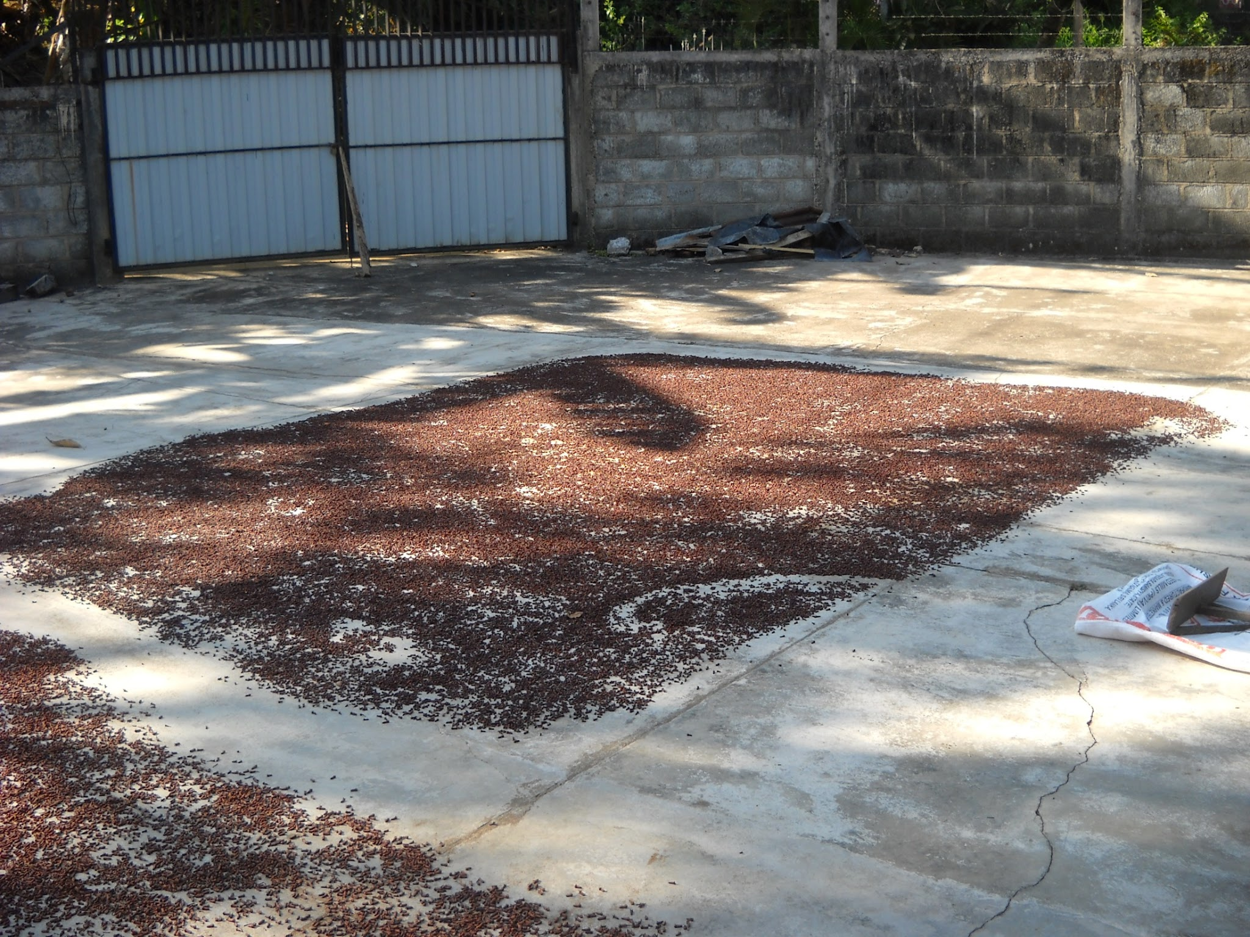
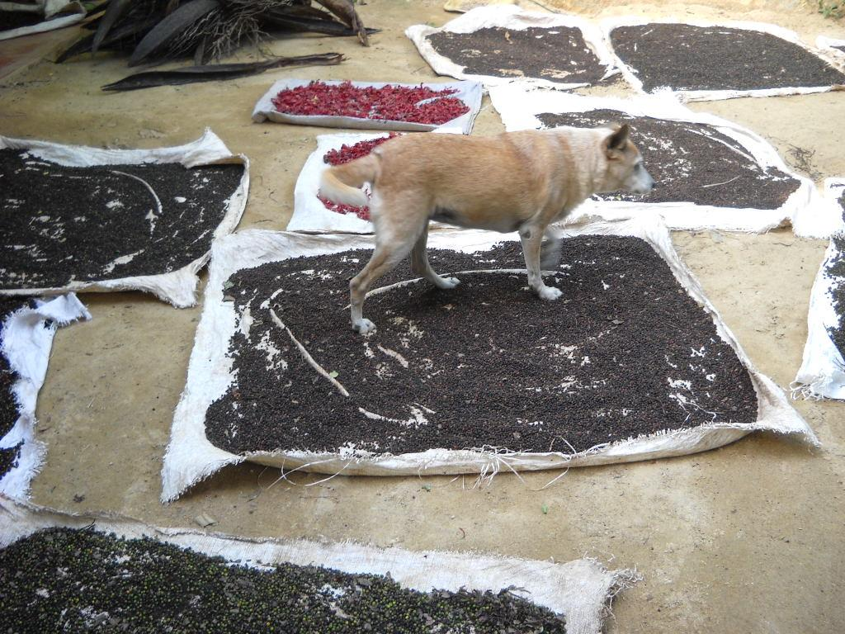

Slide 11
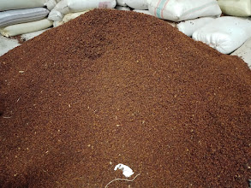
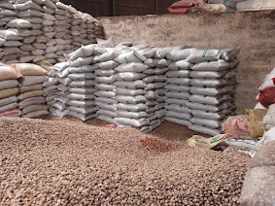
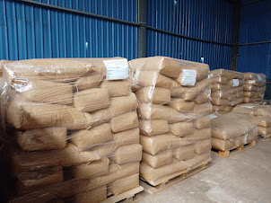
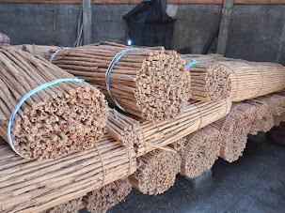

Slide 12
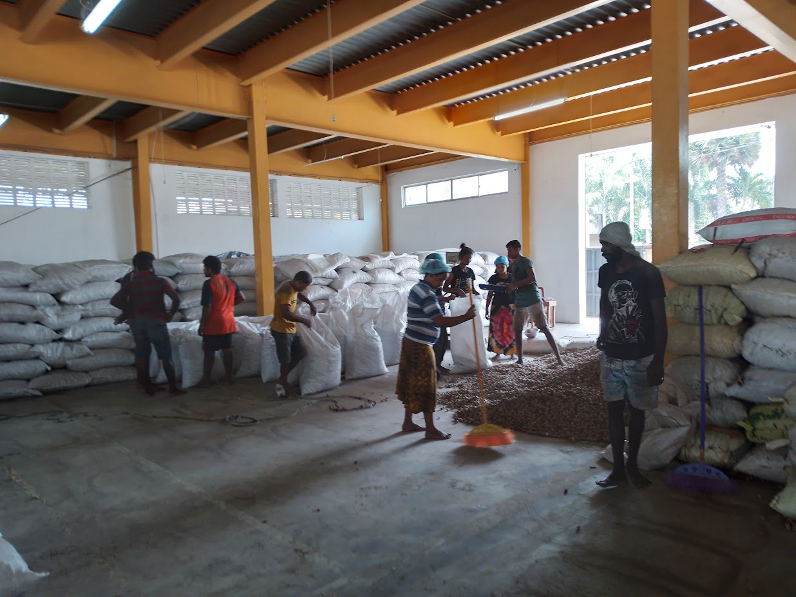

Slide 13
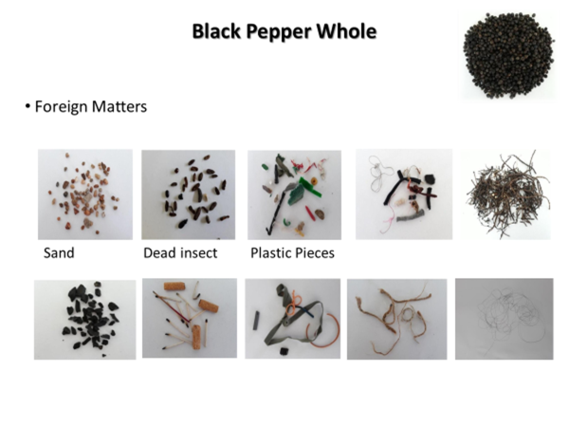
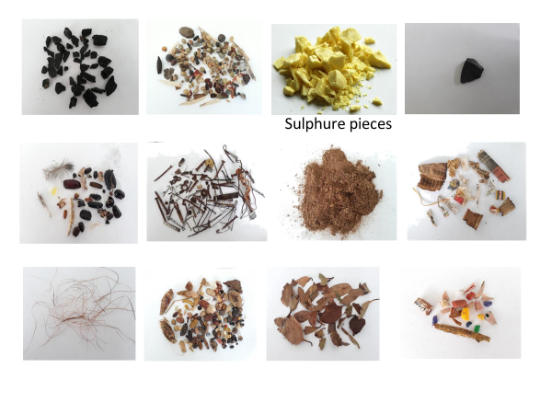

Slide 14
Potential of Sri Lankan EAC

Slide 15
Characteristics of Sri Lankan Spices and Beverages
Small Scale Farms
Kandyan Home Garden
Minimum use of Chemicals (IPM/IDM)
Spices and Beverages of SL
Certified (GAP, Organic etc.)
1 Million farmers
High in Intrinsic qualities
Mix Crop Cultivation
High Biodiversity

Slide 16
Intrinsic quality of Spice in Sri Lanka
Ceylon spice has its characteristic pungency, taste and flavor
Essential oil percentage is high
Nutmeg oil percentage on dry basis - 5-7%
Black Pepper oil percentage on a dry basis - 3% - 5%
Clove oil percentage on a dry basis - 17 % - 30%
Cardamom oil percentage on a dry basis - 5% - 7%
Cinnamon oil percentage on a dry basis - 2% - 3%
Ginger oil percentage on a dry basis - 1% - 2%a

Slide 17
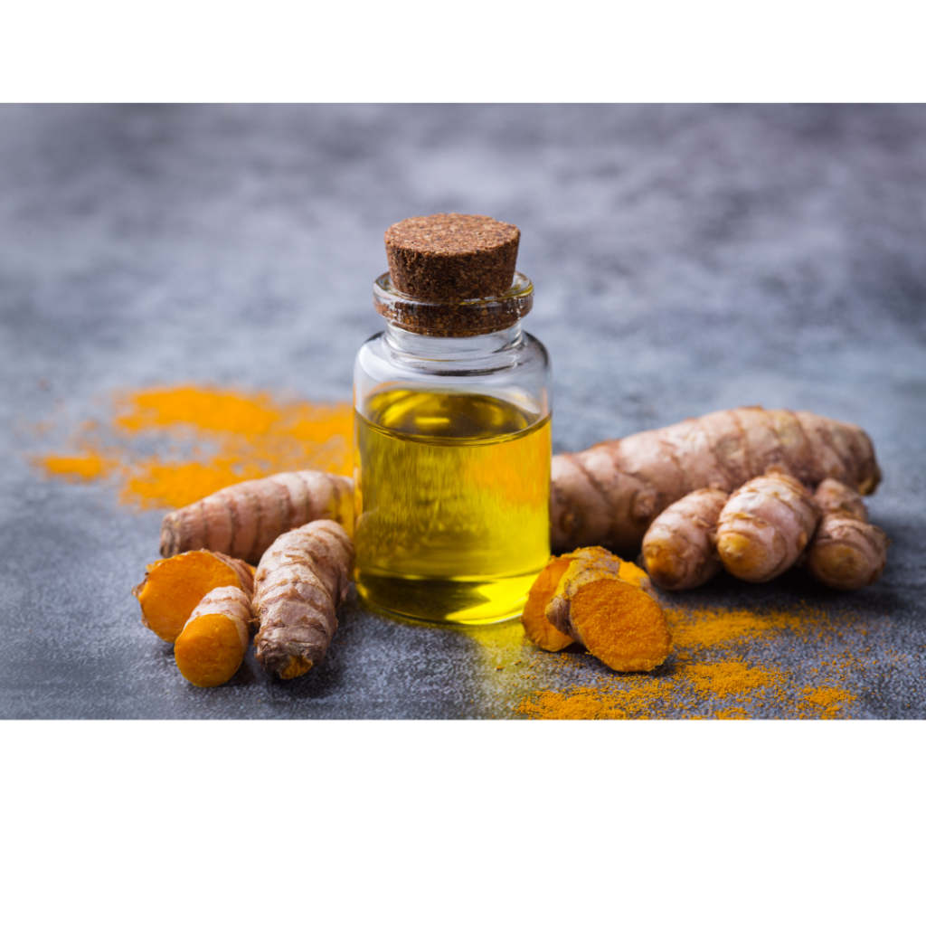
Intrinsic quality……….
The intrinsic quality of Spice in Sri Lanka
Continue…
Oleoresin Percentage
Nutmeg Butter - 25% -35%
Black Pepper Oleoresin on a dry basis - 3% - 5%
Special Chemicals
High piperine percentage in Black pepper - 7% - 12%
High curcumin percentage in Turmeric - 4% -7%
Low Coumarine content in Ceylon cinnamon -<0.002%

Slide 19
Customer Identification

Slide 20
Changing Needs in a Changing World Scenario
Driven by global events, priorities are shifting at an astonishing pace, leading to rapid changes in consumer needs
60% of individuals are experiencing a shift in consciousness regarding their lifestyles
Change 1: Increasing demand for essential goods in daily life】
• Decrease in outing opportunities
• Prevalence of remote work
• Demand for essential goods and items in daily life Expense saving)
Change 2：Increase in E-commerce sites
• Purchase furniture, appliances, groceries, and clothing through an e-commerce site (no in-store shopping).
• Increased demand for healthy foods and supplements.
• Emphasis on review-based purchasing.
Change 3: Purchase at Appropriate Prices
• Economic and income uncertainties (external factors).
• Research before making purchases.
• Opting for discounted prices

Slide 21
Changing Needs in a Changing World Scenario
Evolving consumer landscape
Goods consumption
Experiential consumption
Meaning and moment consumption

Slide 22
Present Consumer Behaviour
SIPS
Sympathize
Identify
Participate
Share & Spread
Sensing resonance with the source or company and empathy towards word-of-mouth
Verifying information that is beneficial to oneself through search, media, friends, etc
Liking, participating in communities, and making purchases
The shared information spreading further within the network of connections

Slide 23
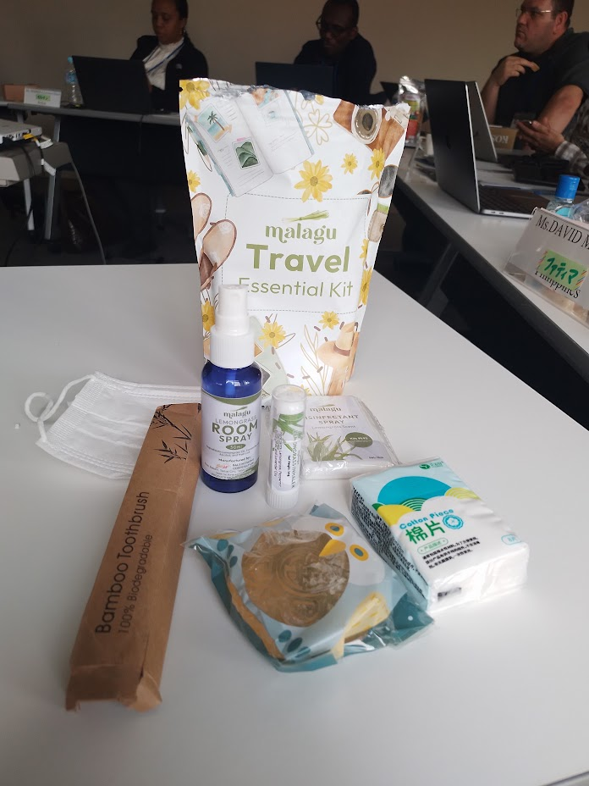
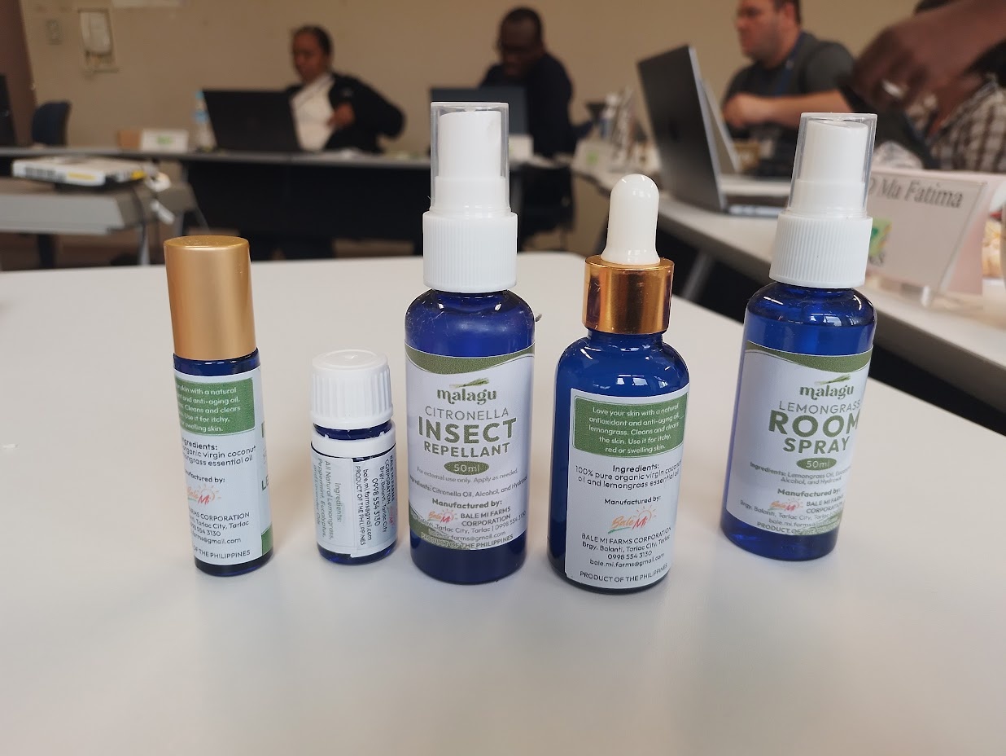
Essential Travel Kit (Lemongrass)

Slide 24
Competitor Identification

Slide 25
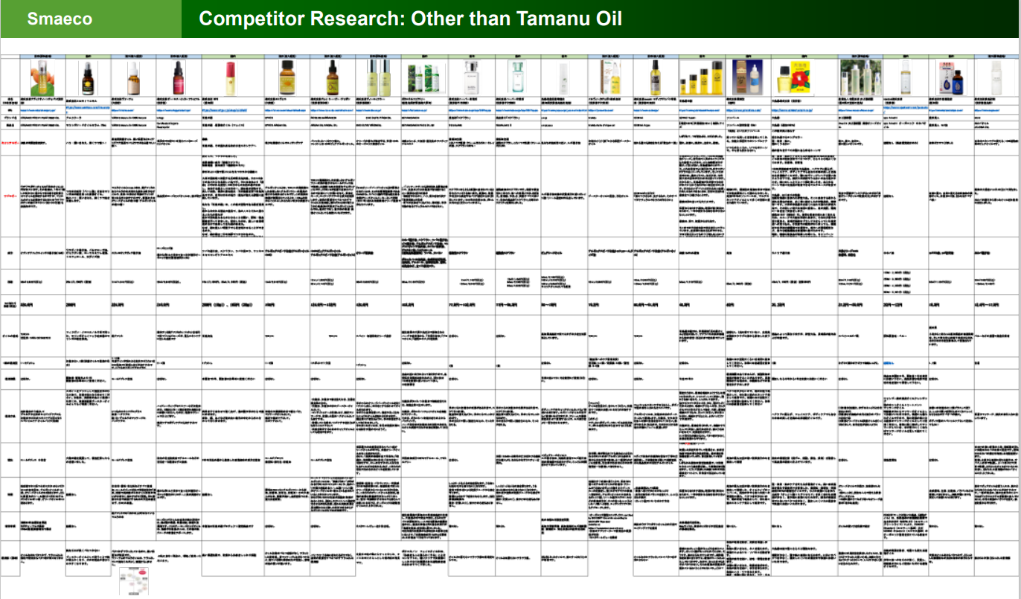

Slide 26
Branding

Slide 27
Formulation of a brand concept
Product and Services
Customer / Stakeholder
 | Existing value | Added value
Segment characteristics | Touch points | Targets
Value Promise ＝ Brand Concept

Slide 28
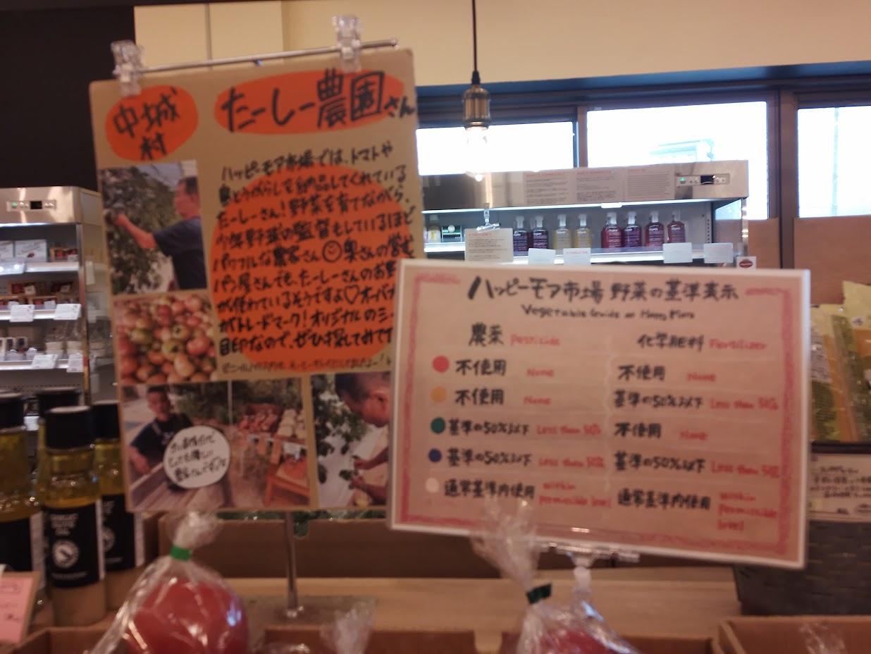
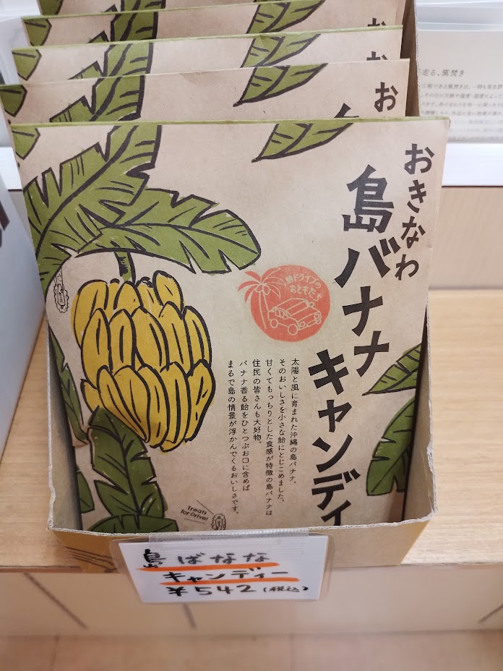
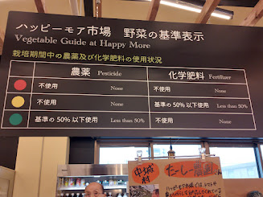
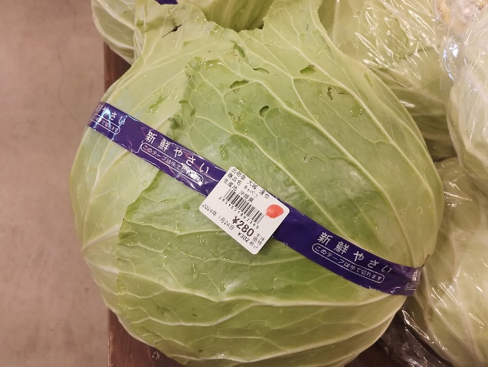
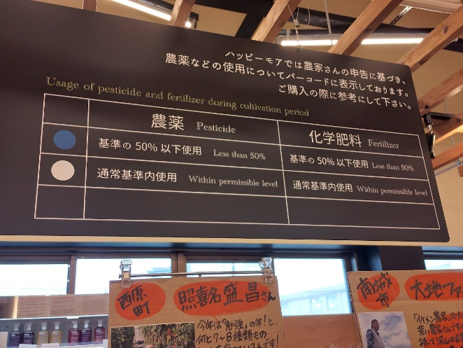

Slide 29
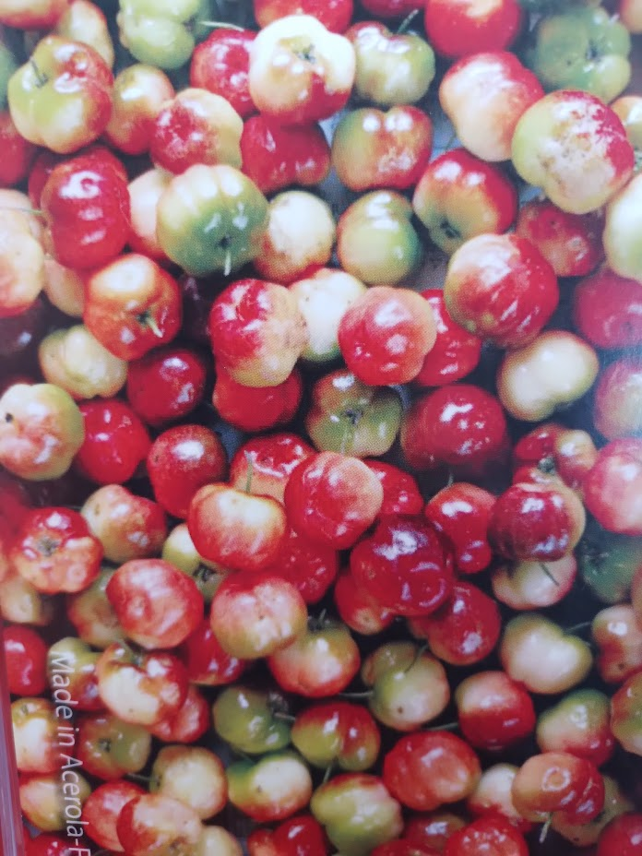
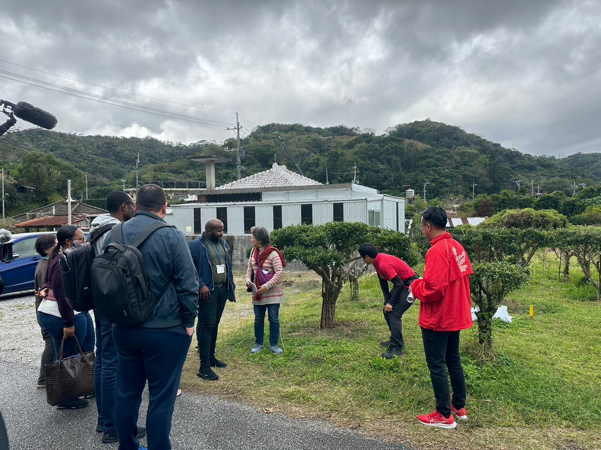
Okinawa Acerola Fresh

Slide 30
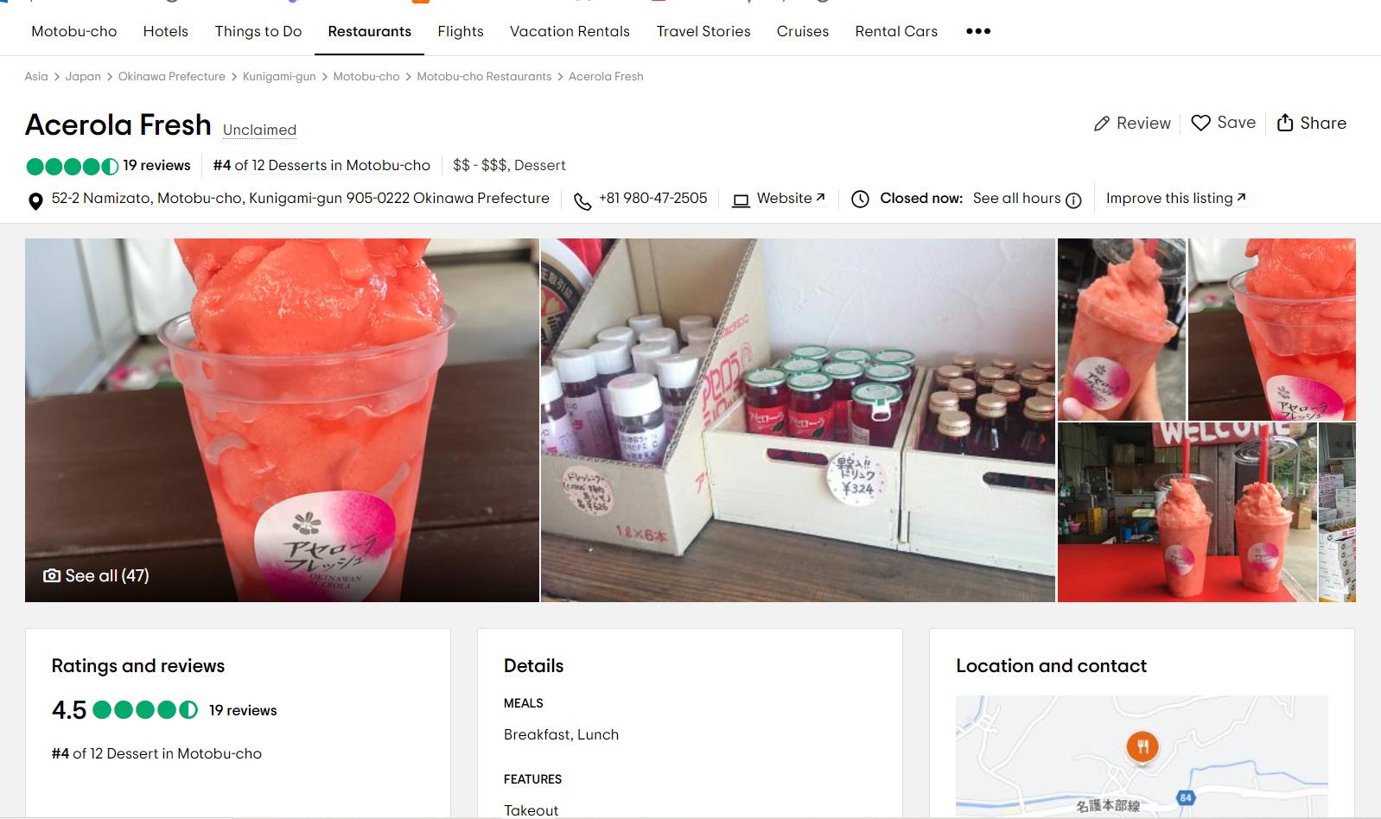

Slide 31
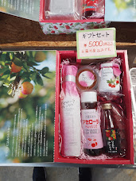
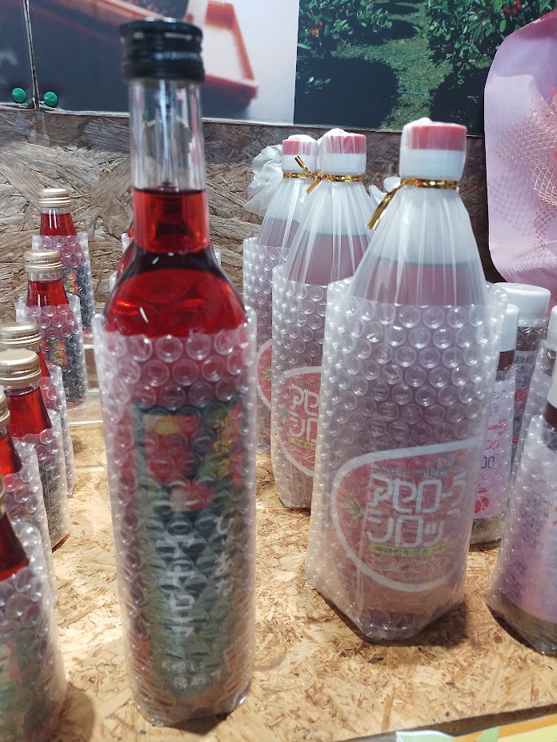
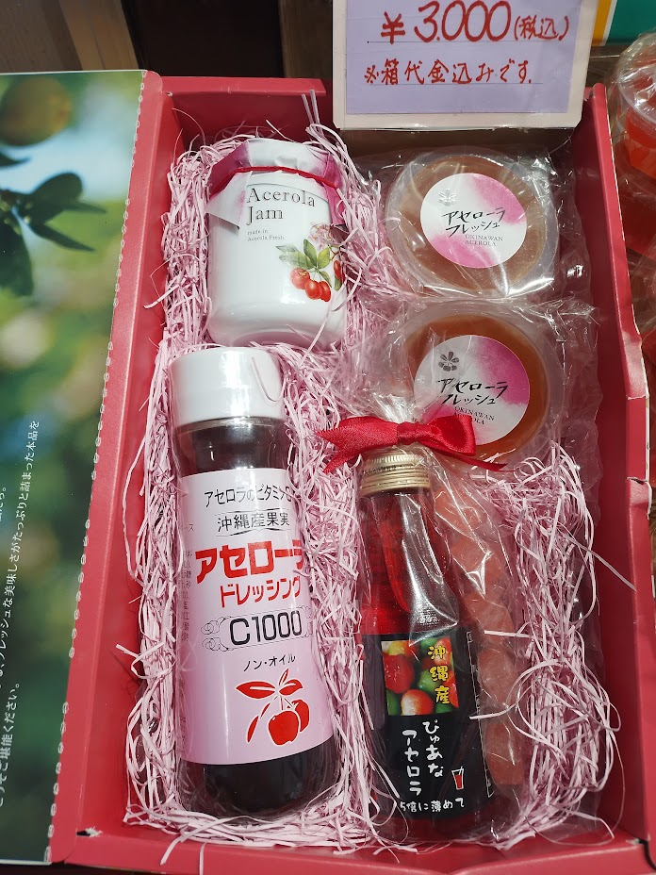
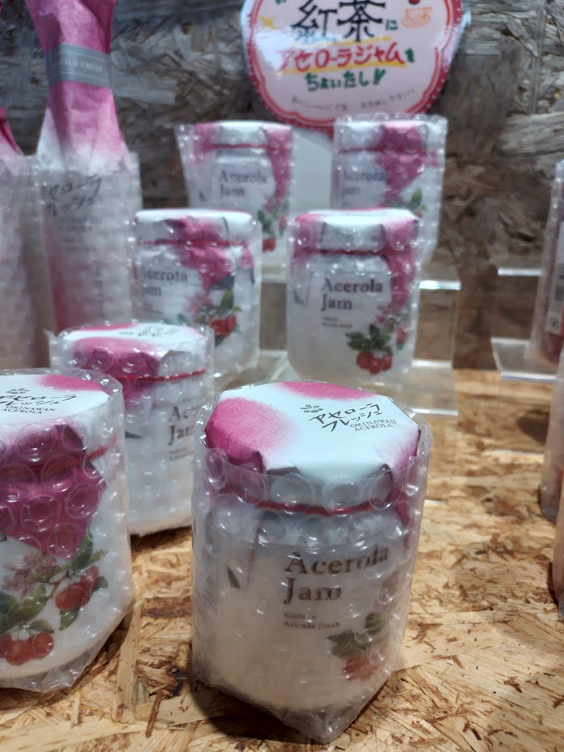

Slide 32
Certification

Slide 33
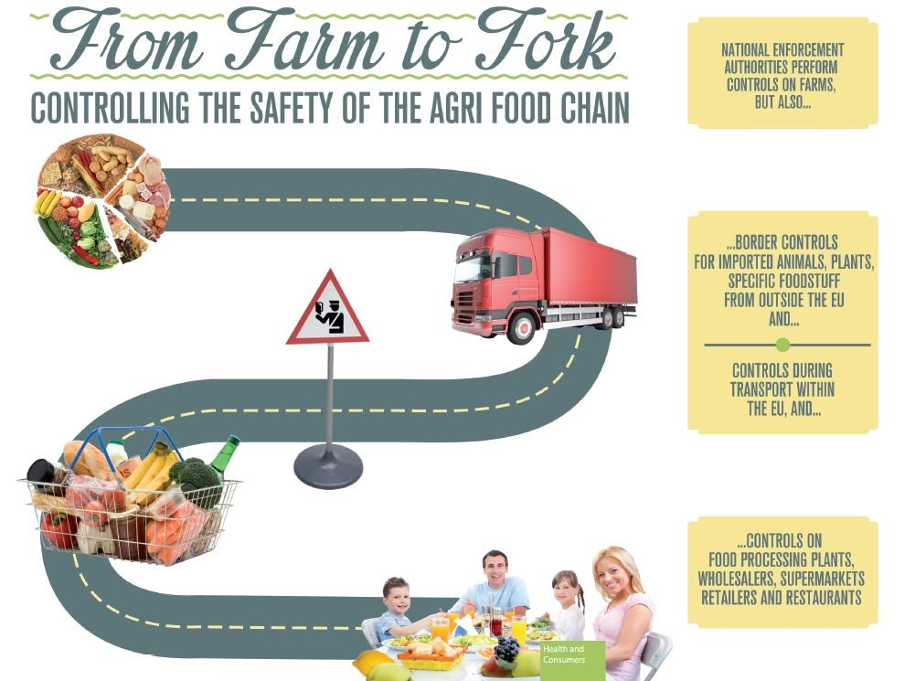

Slide 34
What is Standard?
A Document that provides
Requirements, Specifications, Guidelines or Characteristics
Which consistently ensures
Materials, Products, Process and Services
Are fit for their purpose.

Slide 35
Quality related issues
Quality parameters
Moisture content
Volatile oil
Sulphur dioxide (SO2)
Pesticides
Mold/ Fungi, insect species.
Heavy metals
Mycotoxins
Bulk Density
Microbiology
Foreign matter
Extraneous matter

Slide 36
Standard
System Standards
Product Standard

Slide 37
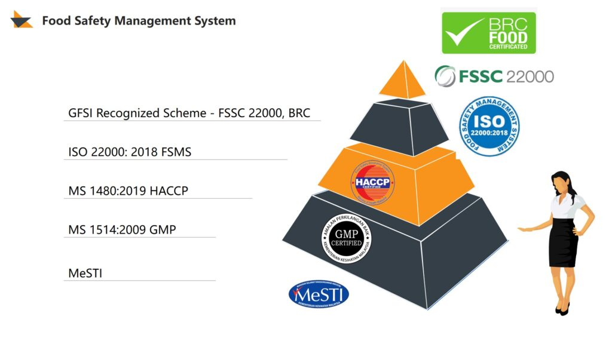

Slide 38
Department of Export Agriculture Post Harvest Assistance Scheme

Slide 39
Programs……
Pre Harvest Machinery
Post Harvest Processing Machinery
Small /Medium Processing Centers
Central Processing Centers
Essential Oil Distillation Units (New/Repair)
Storage Facilities
Value Addition Industry Facilities
Entrepreneur Assistant Scheme

Slide 40
Post Harvest Machinery
Pepper |  |  |  | Capacity (Minimum) | Subsidy per unit (Rs(Maximum )
1 | a | Blancher |  | 20-25 Kg | 40,000.00
 | b | Decorticator (White Pepper) |  | 150Kg/hr | 40,000.00
 | c | Pepper thresher
 |  | i | Manual | 100Kg/hr | 40,000.00
 |  | ii | Electricity | 350-500Kg/hr | 100,000.00
 |  | iii | Motor | 350-500Kg/hr | 100,000.00
 | d | Shifter- Green Berry separator |  | 250Kg/hr | 100,000.00
 | e | Pepper Grading
 |  | i | Grader (2 Grades) | 150-250Kg/hr | 60,000.00
 |  | ii | Winnower (3 grades) | 150-200Kg/hr | 100,000.00
 | f | De-Stoning |  | 200-250Kg/hr | 150,000.00
 | g | Hand Sieves-No6/8/10 net size |  | 2’x2’x3” | 2,500.00

Slide 41
Post Harvest Machinery
Coffee |  |  |  | Capacity (Minimum) | Subsidy per unit (Rs(Maximum )
2 | a | Coffee Pulper- Disc/Rotary
 |  | i | Manual | 100Kg/hr | 25,000.00
 |  | ii | Motor/electricity (include:Washing ) | 250Kg/hr | 45,000.00
 | b | Huller (Removing parchment ) |  | 250Kg/hr | 45,000.00
Cocoa |  | Capacity (Minimum) | Subsidy per unit Rs. (Maximum )
3 | Fermentation Box | 2’x2’x3’ < | 2,500x3= 7,500

Slide 42
Post Harvest Machinery
Other ……… |  |  |  | Capacity (Minimum) | Subsidy per unit (Rs(Maximum )
1 | a | Ginger/Turmeric Slicer
 |  | i | Manual | 30Kg/hr | 25,000.00
 |  | ii | Electricity | 50Kg/hr | 50,000.00
 |  | iii | electricity | 100Kg/hr | 80,000.00
 | b | Ginger Turmeric Washer |  | 200-250Kg/hr | 100,000.00
 | c | Turmeric polisher
 |  | i | Manual | 20Kg | 40,000.00
 |  | ii | Electricity | 25-50Kg | 60,000.00
 |  |  |  | 51<Kg | 80,000.00
 | d | Turmeric Boiler |  | 20-25Kg | 40,000.00
 | e | Turmeric Steamer |  | 20-25Kg | 40,000.00
 |  |  |  | 26Kg< | 60,000.00

Slide 43
Post Harvest Machinery
Other ….. |  |  | Capacity (Minimum) | Subsidy per unit (Rs(Maximum )
4 | f | Turmeric pulper Making machine | i- 20-25 l Ii 26 l< | 50,000.00 60,000.00
 | g | Crusher | 30Kg/hr | 75,000.00
 | h | Grinder | 50Kg/hr | 75,000.00
 | i | Nutmeg Sheller | 50Kg/hr | 125,000.00
 | j | Vanilla Curing Box | 100Kg/hr | 25,000.00
 | k | Coffee Roaster | 20 Kg | 100,000.00
 |  |  | 26Kg <
 | l | Cinnamon Cutting Machine | Normal
 | m | Polythene sealer | Normal | 35,000.00
 |  |  | Special (Auto) | 55,000.00

Slide 44
Post Harvest Machinery
Dryer (wood & Fuel ) |  |  | Capacity (Minimum) | Subsidy per unit (Rs(Maximum )
5 | a | Dryer (Multi crop, cooling. Vacuum ) (new )
 |  | i cabinet (New) | I 50-150kg | 250,000.00
 |  |  | Ii 151-250 | 350,000.00
 |  |  | Iii 251-400 | 500,000.00
 |  |  | Iv 401 kg< | 600,000.00
 |  | ii Flat bed (new) | i 25-100 kg | 75,000.00
 |  |  | ii 101-200kg | 150,000.00
 |  |  | iii 201-300kg | 250,000.00
 |  |  | Iv 400kg< | 400,000.00
 |  |  | v 451-1500kg | 500,000.00
 |  |  | Vi 1501kg< | 600,000.00
 |  | iii Ozone Dryer (New) | 200-250kg< | 600,000.00
 | b | Cardamom bar (new) | 250< | 300,000.00

Slide 45
Post Harvest Machinery
Dryer |  |  |  | Capacity (Minimum) | Subsidy per unit (Rs (Maximum )
5 | a | Dryer (Multi Crop) (Repair)
 |  | Cabinet (Repair) |  | I 50-150kg | 100,000.00
 |  |  |  | ii 51-250kg | 150,000.00
 |  |  |  | Iii 251-400kg | 200,000.00
 |  |  |  | Iv 401kg&< | 250,000.00
 |  | Flat bed (Repair) |  | I 200-300 kg | 100,000.00
 |  |  |  | Ii 301-450 kg | 150,000.00
 |  |  |  | iii 451-1500kg kg | 200,000.00
 |  |  |  | iv 1501 kg & < | 300,000.00
 |  | cardamom bar (repair) |  | 250kg&< | 150,000.00
 |  | solar dryer (new) |  | minimum 100 sq.feet | 50,000.00
 |  | drying floor (new) |  | minimum 200 sq. feet | 75,000.00

Slide 46
Post Harvest Machinery
 |  |  | Capacity (Minimum) | Subsidy per unit (Rs(Maximum )
6 | a | quality testing equipment
 |  | hand sieves, moisture meter, measuring cylinder, balance, magnified glass |  | 50,000.00
7 | a | Other required equipment | 60% of the invoice /maximum 600,000.00 | 600,000.00

Slide 47
Processing Centers
Type of building |  |  |  | Capacity (Minimum) | Subsidy per unit (Rs(Maximum )
1 | Small /Medium
 | i | New building
 |  | a | minimum 400-599 sq.feet |  | 300,000.00
 |  | b | 600-799 sq.feet |  | 400.000.00
 |  | c | 800-1000 sq.feet |  | 500,000.00
 | ii | Old building repair
 |  | a | minimum 400sq.feet /< |  | 200,000.00
 |  |  | i roof repair | 50,000.00
 |  |  | ii ceiling | 35,000.00
 |  |  | iii plaster & painting | 35,000.00
 |  |  | iv paving floor tiles | 40,000.00
 |  |  | v pavement | 20,000.00
 |  |  | vi ventilation | 20,000.00

Slide 48
Processing Centers
2 Central Processing Centers |  |  |  | Capacity (Minimum) | Subsidy per unit (Rs(Maximum )
 | i | Rs mn.2>3 |  | sq. feet 1000< | 850,000.00
 | ii | Rs mn.3>4 |  |  | 1,000,000.00
 | iii | Rs mn.4< |  |  | 1,250,000.00
3 | storage facilities
 | minimum squ. feet 400-500 & invested Rs 300,000.00 – Rs 600,000.00 |  |  |  | 200,000.00
 | squ. feet 501& < & invested Rs 600,000.00< |  |  |  | 300,000.00

Slide 49
Processing Centers
Facilitation for industries in Value addition |  | Capacity (Minimum) | Subsidy per unit Rs. (Maximum )
Invested in
i | Rs Mn 2>3 | sq. feet 1000< | 800,000.00
ii | Rs Mn 3>4 |  | 900,000.00
iii | Rs Mn 4>5 |  | 1,250,000.00
iv | Rs Mn 5< |  | 1,500.000.00

Slide 50
Certification
Type of Certification |  | Subsidy per unit (Rs(Maximum )
GMP
i | Rs Mn 1 | 50,000.00
ii | Rs Mn 1<5 | 75,000.00
iii | Rs Mn 5<10 | 100,000.00
iv | Rs Mn 10 | 125,000.00
BRC/ ISO 22000 / HACCP /FSSC 22000/ BRCGS |  | 250,000.00
One or more certificates |  | 300,000.00

Slide 51
Department of Export Agriculture
For Healthy and Wealthy Tomorrow

